Slide 1
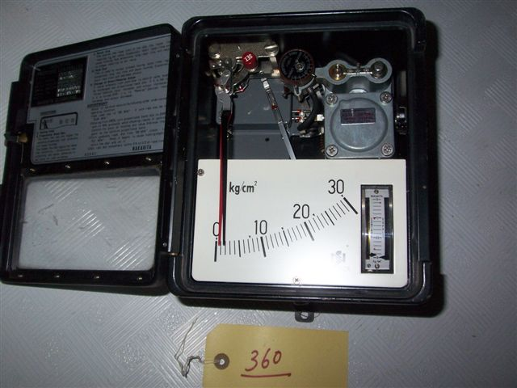
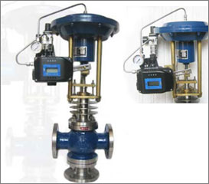
CONTROLS AND AUTOMATION
Mahesh A. Patil C/E
Elstan A. Fernandez ETO

Slide 2
SESSION OBJECTIVES
Revise Terminology
Understanding P I D controller theory
Valve Positioner and Actuator working
Adjustments and system tuning
Practical / Demonstration
Total duration – 120 minutes

Slide 3
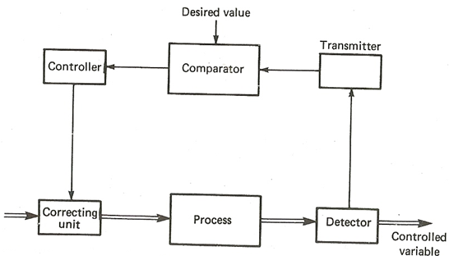
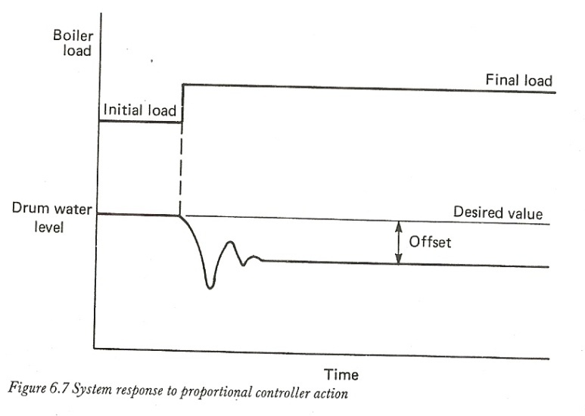
TERMINOLOGY
Open Loop system
Closed Loop System
Set Point
Desired Value (dv)
Measured value (mv)
Actual value (av)
Comparator
Error
Deviation
Offset
Dead Band
Proportional band
Settling Time

Slide 4
TYPES OF CONTROL ACTIONS
STEP CONTROL
ON – OFF CONTROL
SEQUENCIAL CONTROL
PROPORTIONAL CONTROL
P + DERIVATIVE CONTROL
P + INTEGRAL CONTROL
P + I + D CONTROL

Slide 5
P I D Actions
Proportional
Set Point
-
Error
K_{P}
+
Controller Output
t
K_{p}e(t) +
K_{i} ∫ e(t)δt +
K_{d}
δ e(t)
δ t
Integral
0
Process
Variable
K_{i} ∫
+
Derivative
K_{d}
d
δ t
PROPORTIONAL - (m)controller o/p is proportional to deviation { e(t)}
m = - Kp * e(t)
INTEGRAL - Rate of change of (m)controller o/p is proportional to deviation { e(t)}
dm / dt = Ki * e(t)
i.e m = - Ki ∫ e(t) * dt
DERIVATIVE - (m)Controller o/p is proportional to rate of change of deviation { e(t)}
m = - Kd * de(t) / dt

Slide 6
System responses

Slide 7
System basics
Nozzle – Flapper arrangement
Acts as a transducer or an signal amplifier
Supply Air Pr – 1.5 bar
Control air output pr range – 3 ~ 15 psi
Flapper Movement(X₁, X₂₎ approx 20 microns
Orifice Dia – 0.25 mm
Nozzle Dia – 0.40 mm

Slide 8
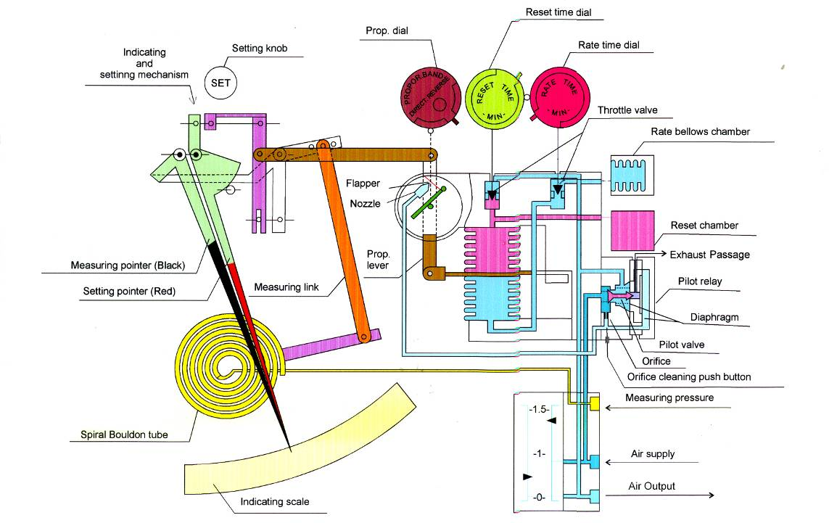
What’s inside- nakakita

Slide 9
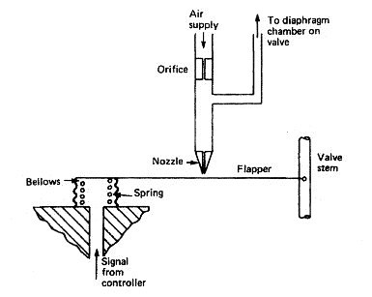
Positioner/actuator

Slide 10
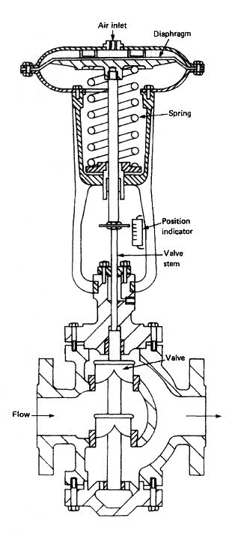
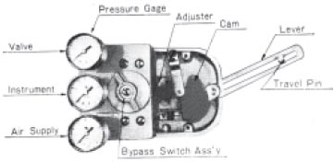
Positioner/actuator

Slide 11
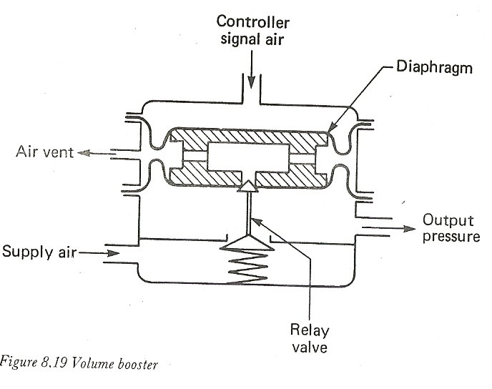
The Pneumatic Relay

Slide 12
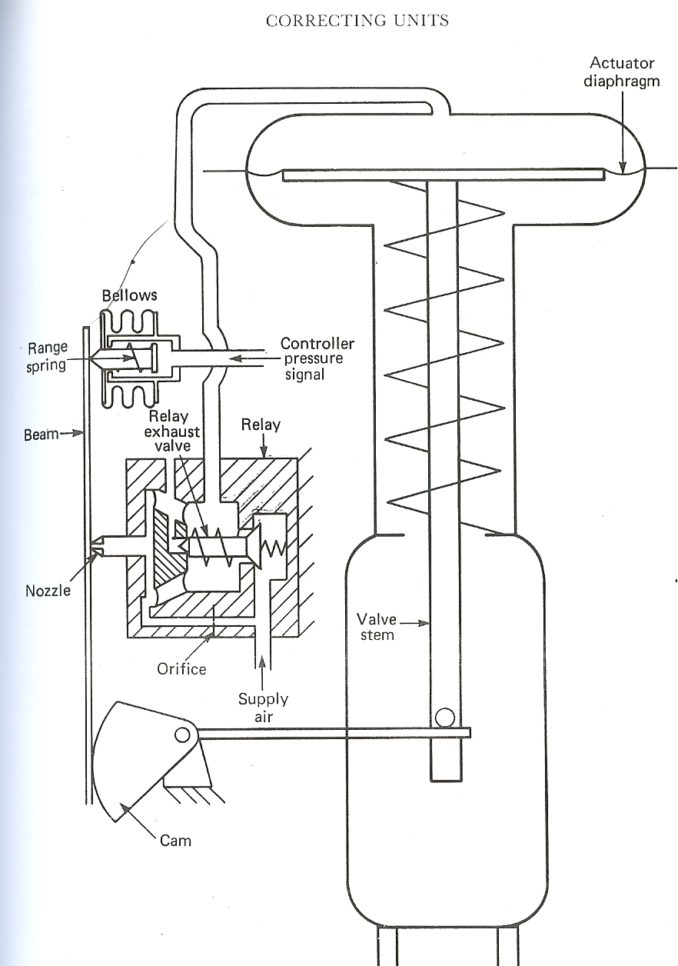
Correcting
Units

Slide 13
Vigilance and Maintenance
Periodic calibration and cleaning of measuring devices/sensors (e.g. RTD probe in the FO purifier heater line, M/E JCW line etc.)
Replacement of polyurethane tubes inside the controller every 24 months, as tubes tend to damage due to heat, oil and vibration.
Quarterly cleaning of nozzle with a thin SS wire (<0.25 mm)
Weekly cleaning of orifice by depressing the push button.
Bellows and linkages must be checked for their intactness.
Watch out for signs of air leakages inside the controller box
Leakages in signal transmission lines from controller to regulating valve.
Valve condition and integrity of valve packing/seals, moving surface of valve spindles.
And most important, cleanliness of supply air. Correct working of filters and Pressure reducers settings.

Slide 14
THANK YOU

